Slide 1
Chapter 12: Mass-Storage Systems 大容量存储系统

Slide 2
Chapter 12: Mass-Storage Systems
12.1 Overview of Mass Storage Structure
12.2 Disk Structure
12.3 Disk Attachment
12.4 Disk Scheduling
12.5 Disk Management
12.6 Swap-Space Management
12.7 RAID Structure
12.8 Stable-Storage Implementation
12.9 Tertiary Storage Devices
12.10 Summary

Slide 3
Objectives
Describe the physical structure of secondary and tertiary storage devices and the resulting effects on the uses of the devices
Explain the performance characteristics of mass-storage devices
Discuss operating-system services provided for mass storage, including RAID and HSM

Slide 4
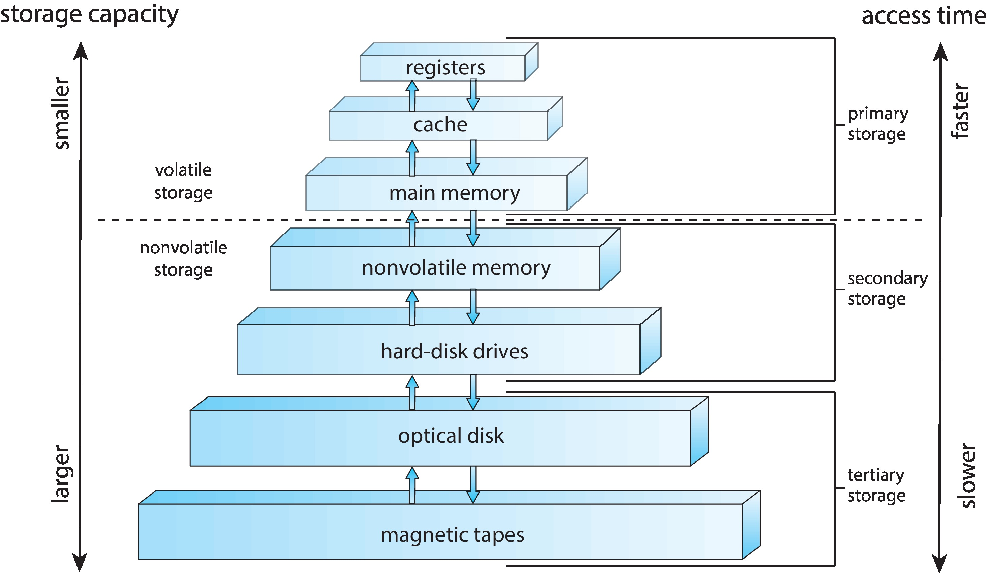
Hierarchical Storage Architecture
大容量存储器

Slide 5
Hierarchical Storage Architecture
智能时代，数据增长的速度将超过摩尔定理
存储场景
全世界总人口超过73亿，亚洲总人口超过 40亿。
互联网用户超过40亿;70亿手机用户。
2016年全球数据总量12ZB，预计到2020年将到达44ZB(相当于全球每人5.2TB )，2025年甚至达到163ZB。
所有数据中约42%是重复的（至少重复一次）。
所有数据中约33%是压缩的（2次）。
所有数据中约5%是瞬态的（临时的）。
所有数据中7%是非结构化结构（很难浏览）。

Slide 6
12.1Overview of Mass Storage Structure

Slide 7
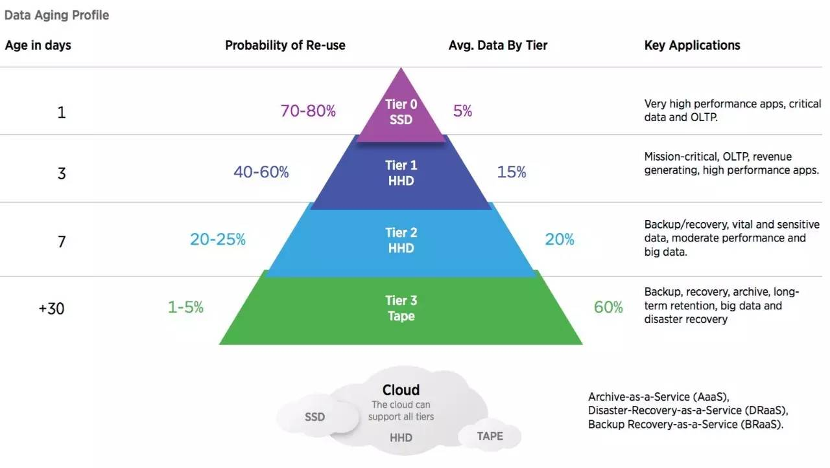
Overview of Mass Storage Structure
分层存储体系

Slide 8
Overview of Mass Storage Structure
Magnetic disks（磁盘） provide bulk of secondary storage of modern computers
Drives rotate at 60 to 200 times per second
Transfer rate is rate at which data flow between drive and computer
Positioning time (random-access time) is time to move disk arm to desired cylinder (seek time) and time for desired sector to rotate under the disk head (rotational latency)
Head crash results from disk head making contact with the disk surface
That’s bad
Disks can be removable
Drive attached to computer via I/O bus
Buses vary, including EIDE, ATA, SATA, USB, Fibre Channel, SCSI
Host controller in computer uses bus to talk to disk controller built into drive or storage array

Slide 9
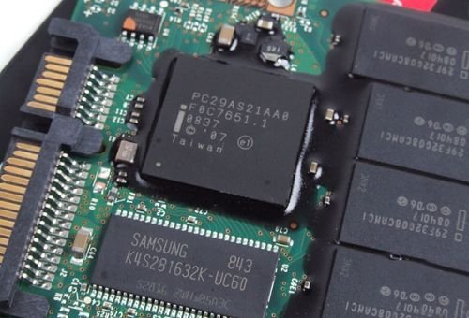
Overview of Mass Storage Structure (Cont)
固态硬盘（Solid State Drives），简称固盘，固态硬盘用固态电子存储芯片阵列制成的硬盘，由控制单元和存储单元（FLASH芯片、DRAM芯片）组成。
第一只SSD出现在1978年（STK 4305，每MB售价8800美元，DRAM）。
全闪存阵列（AFAS）和混合闪存阵列（HFA）呈爆发式增长。
现在SSD的容量是15.36TB（SAS）。
非易失性、低功耗（只有HDD的三分之一）。
无活动部件、可靠性高――位误码率（BER）1 x 10 ⁻¹⁷
读取存取时间：0.2毫秒，存取时间比HDD大概快 50倍。

Slide 10
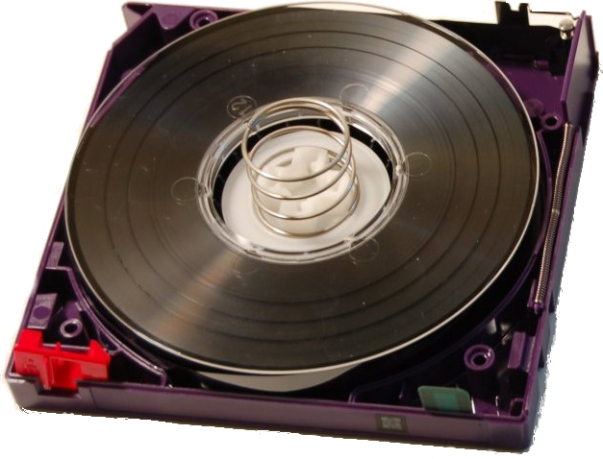
Overview of Mass Storage Structure (Cont)
Magnetic tape （磁带）
出货的磁带驱动器中超过85%是LTO（Linear Tape Open）。
磁带驱动器的可靠性、数据传输速率和容量已超过磁盘。
磁带的原生容量为10TB，压缩容量超过25TB。(LTO-10:48TB)
磁带的原生数据传输速率为360MB/s。
LTFS(Liner Tape File System)为磁带提供了一种通用、开放的文件系统。
由于总体拥有成本，云采用磁带解决方案用于归档服务。
对企业级磁带和LTO而言，磁带介质的寿命至少是30年。

Slide 11
12.2 Disk Structure

Slide 12
Disk Structure
Disk drives are addressed as large 1-dimensional arrays of logical blocks, where the logical block is the smallest unit of transfer
The size of the logical block is usually 512 bytes
The 1-dimensional array of logical blocks is mapped into the sectors of the disk sequentially
Sector 0 is the first sector of the first track on the outermost cylinder
Mapping proceeds in order through that track, then the rest of the tracks in that cylinder, and then through the rest of the cylinders from outermost to innermost

Slide 13
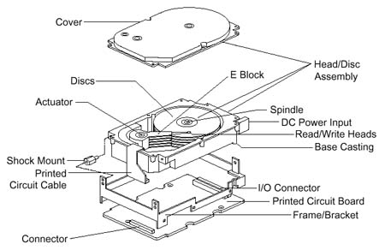
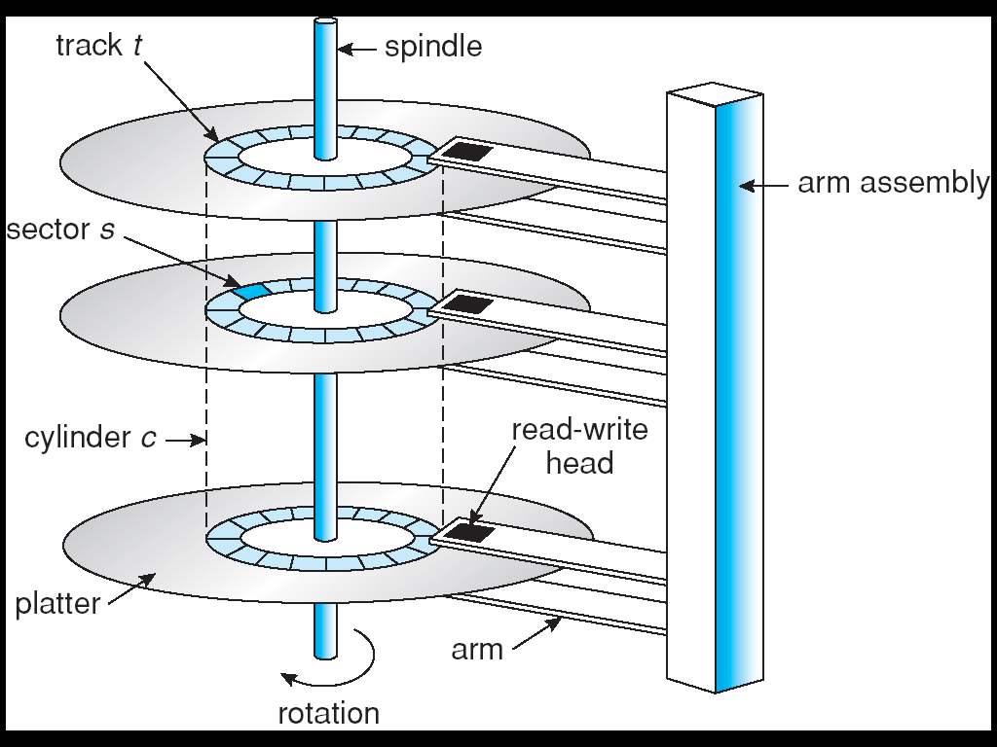
Moving-head Disk Mechanism

Slide 14
Host-attached storage
Host-attached storage accessed through I/O ports talking to I/O busses
I/O bus like IDE
a maximum of 2 drives per I/O bus
SCSI itself is a bus, up to 16 devices on one cable, SCSI initiator requests operation and SCSI targets perform tasks
Each target can have up to 8 logical units (disks attached to device controller）
FC（Fibre Channel，光纤通道 ） is high-speed serial architecture
Can be switched fabric with 24-bit address space – the basis of storage area networks (SANs) in which many hosts attach to many storage units
Can be arbitrated loop (FC-AL) of 126 devices

Slide 15
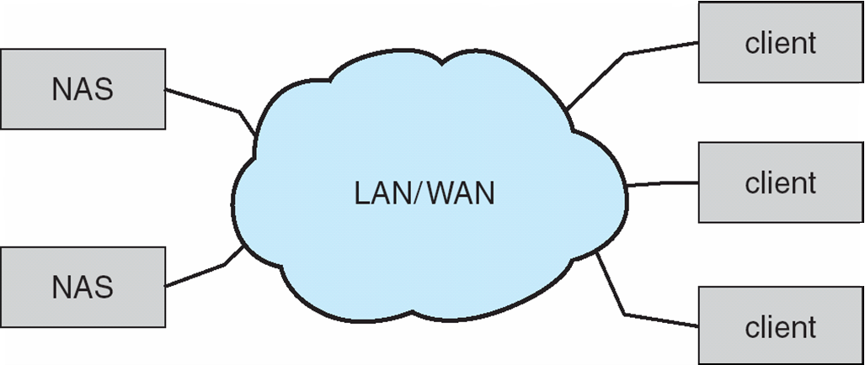
Network-Attached Storage
Network-attached storage (NAS) is storage made available over a network rather than over a local connection (such as a bus)
NFS and CIFS (Common Internet File System) are common protocols
Implemented via remote procedure calls (RPCs) between host and storage
New iSCSI protocol uses IP network to carry the SCSI protocol

Slide 16
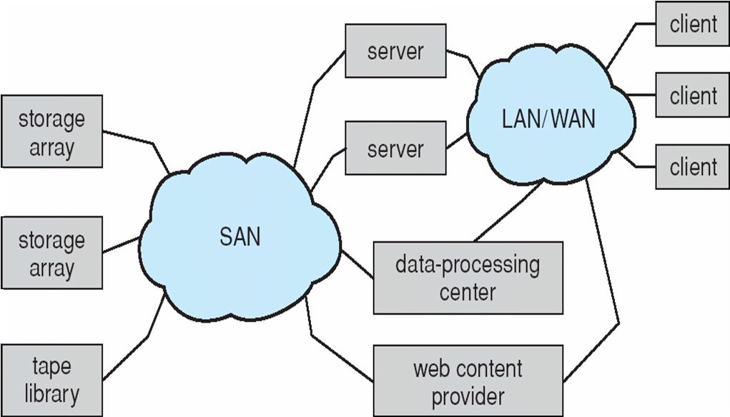
Storage Area Network（SAN）
Common in large storage environments (and becoming more common)
Multiple hosts attached to multiple storage arrays - flexible

Slide 17
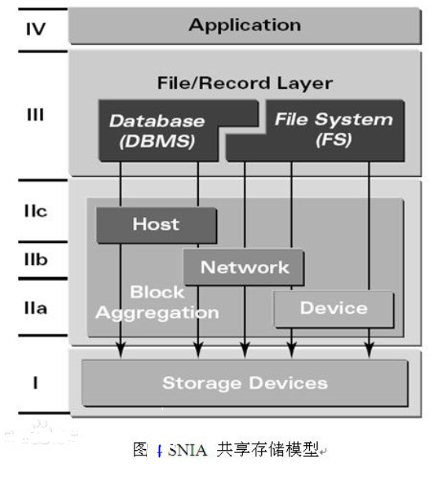
存储虚拟化技术
SNIA（Storage Networking Industry Association，存储网络联合会）官方对于Virtualization（存储虚拟化技术）的定义，如下：
是将存储（子）系统内部功能与具体应用、主机及通用网络资源分离、隐藏及抽象的行为。以期达到存储或数据管理的网络无关性。
对于存储服务及设备的虚拟化应用，以期达到整合设备功能、隐藏复杂细节以及向已经存在的底层存储资源添加新的应用。

Slide 18
12.4 Disk Scheduling

Slide 19

Disk Scheduling
The operating system is responsible for using hardware efficiently — for the disk drives, this means having a fast access time and disk bandwidth
Access time has three major components
Seek time（寻道时间） is the time for the disk are to move the heads to the cylinder containing the desired sector
Rotational latency（旋转延迟）is the additional time waiting for the disk to rotate the desired sector to the disk head
Transfer time (传输时间)
Minimize seek time
Seek time ≈ seek distance 寻道时间 ≈ 寻道距离
Disk bandwidth is the total number of bytes transferred, divided by the total time between the first request for service and the completion of the last transfer

Slide 20
数据计算
7200(转／每分钟)的硬盘，每旋转一周所需时间为60×1000（毫秒）÷7200＝8.33毫秒， 则平均旋转延迟时间为8.33÷2＝4.17毫秒(平均情况下，需要旋转半圈)。
7200转机械硬盘的寻道时间一般为12-14毫秒，固态硬盘可以达到0.1毫秒甚至更低。
固态硬盘持续读写速度超过500MB/s
机械硬盘读写速度超过50~200MB/s（接口不同）
磁带的原生数据传输速率为360MB/s。

Slide 21
Disk Scheduling (Cont)
Several algorithms exist to schedule the servicing of disk I/O requests
常用的磁盘调度算法有：先来先服务(FCFS)、最短寻道时间优先(SSTF)、扫描(SCAN)算法和循环扫描(C-SCAN)算法等
We illustrate them with a request queue (0-199)
98, 183, 37, 122, 14, 124, 65, 67
Head pointer 53

Slide 22
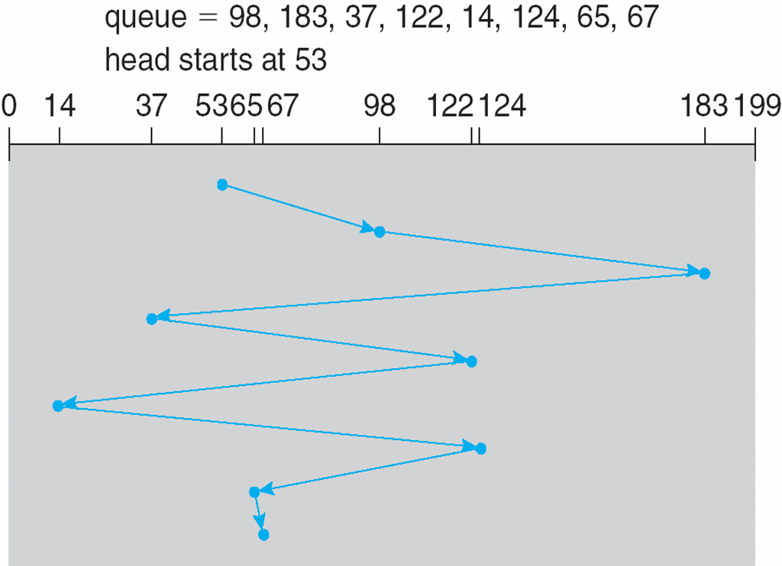
FCFS 先来先服务
Illustration shows total head movement of 640 cylinders

Slide 23
SSTF 最短寻道时间优先
Selects the request with the minimum seek time from the current head position
SSTF(Shortest Seek Time First) scheduling is a form of SJF scheduling; may cause starvation of some requests
Illustration shows total head movement of 236 cylinders

Slide 24
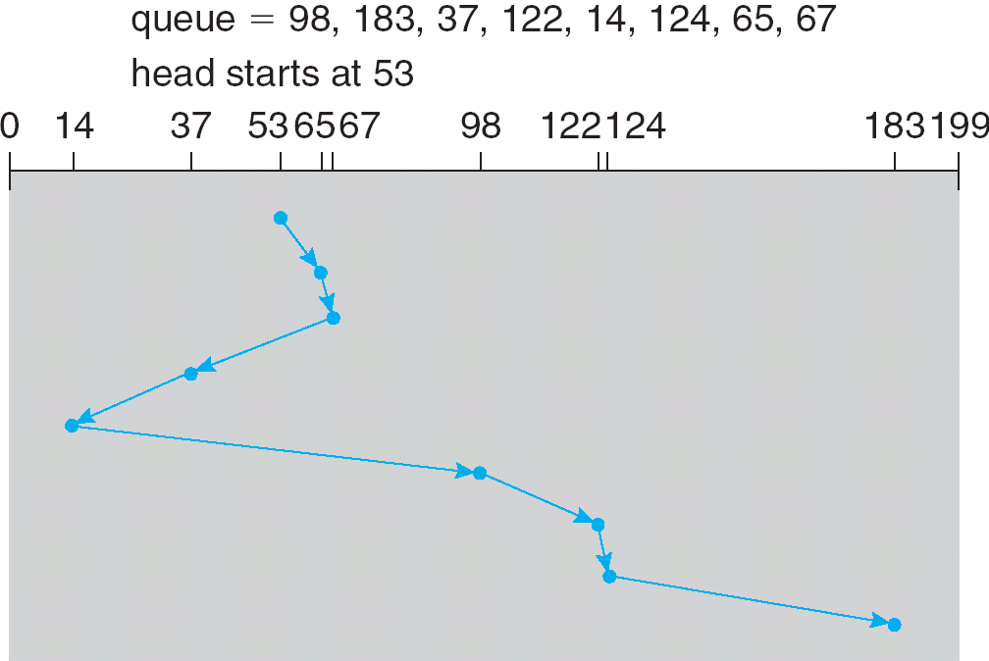
SSTF (Cont)
total head movement of 236 cylinders

Slide 25
SCAN扫描
The disk arm starts at one end of the disk, and moves toward the other end, servicing requests until it gets to the other end of the disk, where the head movement is reversed and servicing continues.
SCAN algorithm Sometimes called the elevator algorithm
Illustration shows total head movement of 236 cylinders

Slide 26
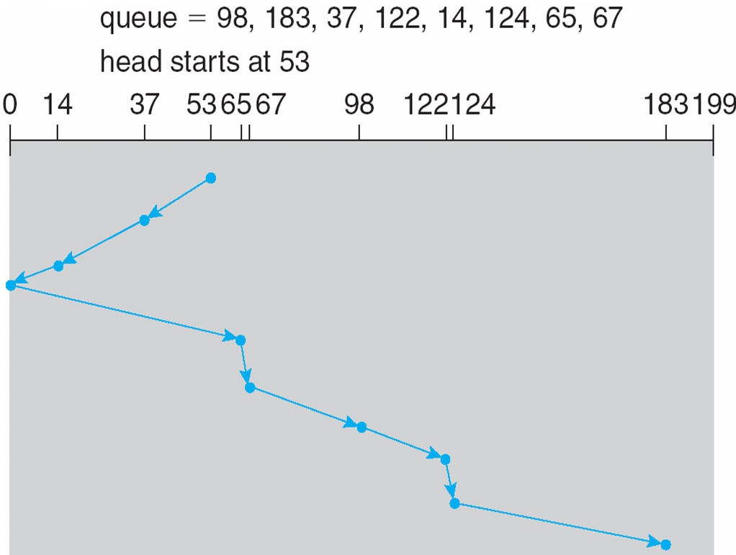
SCAN (Cont.)

Slide 27
C-SCAN
Provides a more uniform wait time than SCAN
The head moves from one end of the disk to the other, servicing requests as it goes
When it reaches the other end, however, it immediately returns to the beginning of the disk, without servicing any requests on the return trip
Treats the cylinders as a circular list that wraps around from the last cylinder to the first one

Slide 28
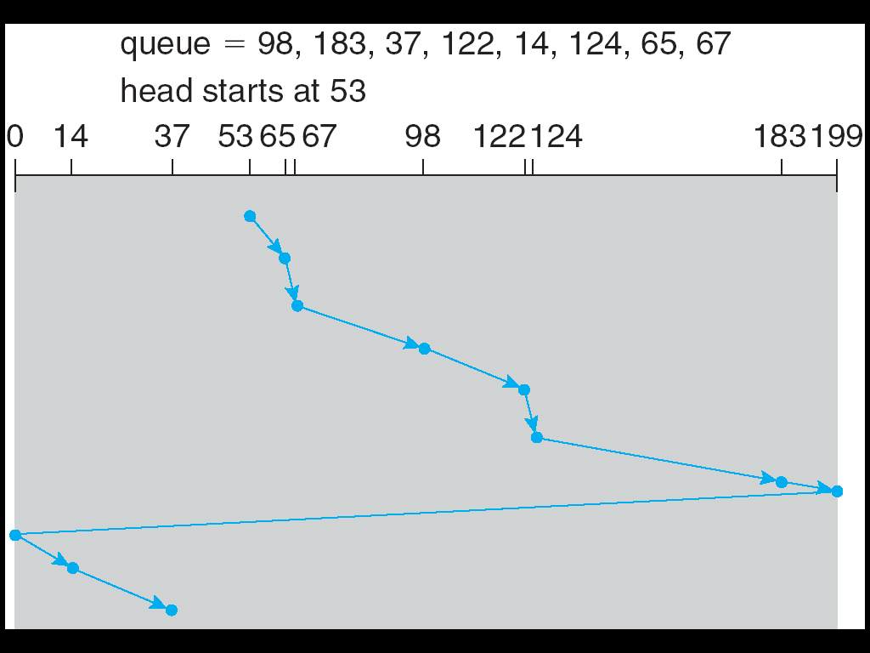
C-SCAN (Cont)
total head movement of 382 cylinders

Slide 29
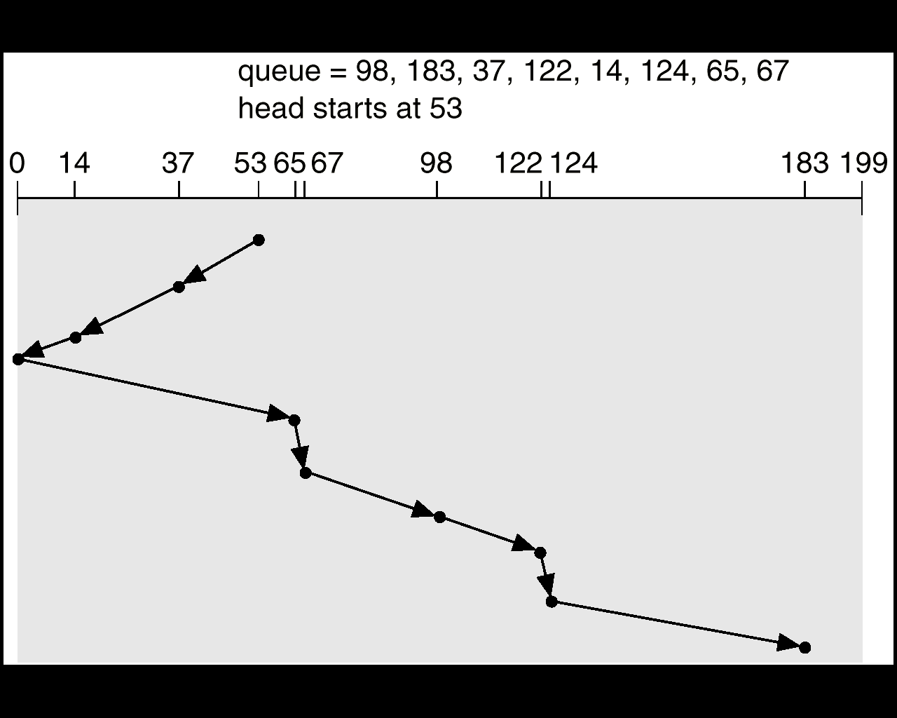
LOOK-- Version of SCAN
LOOK 208
total head movement of 208 cylinders

Slide 30
C-LOOK
Version of C-SCAN
Arm only goes as far as the last request in each direction, then reverses direction immediately, without first going all the way to the end of the disk

Slide 31
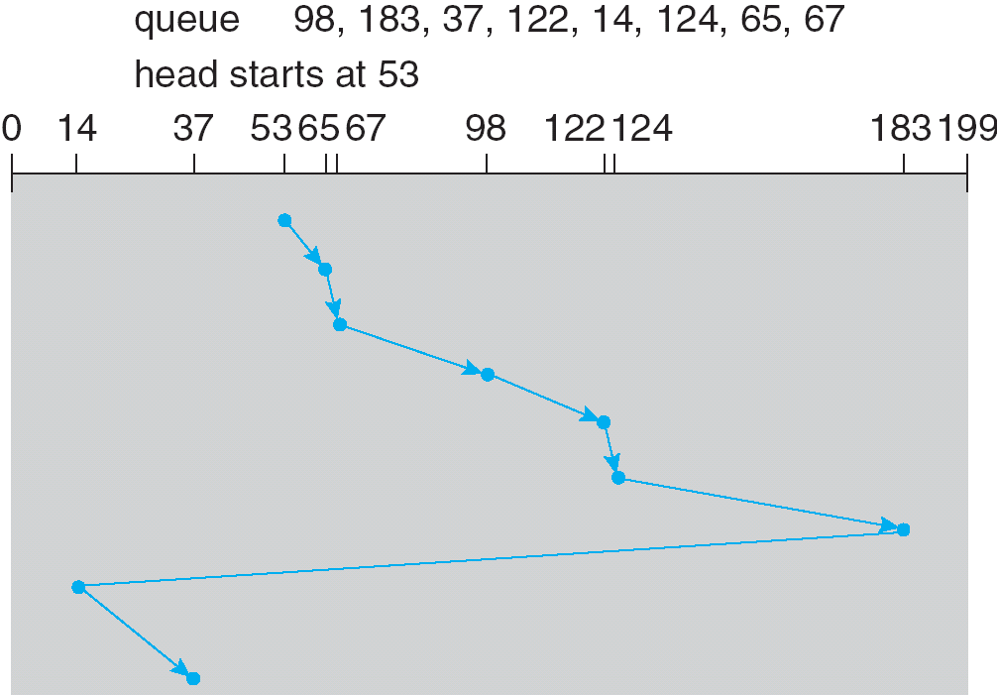
C-LOOK (Cont)
C-LOOK 322

Slide 32
Selecting a Disk-Scheduling Algorithm
SSTF is common and has a natural appeal
SCAN and C-SCAN perform better for systems that place a heavy load on the disk
Performance depends on the number and types of requests
Requests for disk service can be influenced by the file-allocation method
The disk-scheduling algorithm should be written as a separate module of the operating system, allowing it to be replaced with a different algorithm if necessary
Either SSTF or LOOK is a reasonable choice for the default algorithm

Slide 33
12.5 Disk Management

Slide 34
Disk Management
Low-level formatting（低级格式化）, or physical formatting — Dividing a disk into sectors that the disk controller can read and write
To use a disk to hold files, the operating system still needs to record its own data structures on the disk
Partition the disk into one or more groups of cylinders
Logical formatting （逻辑格式化）or “making a file system”
To increase efficiency most file systems group blocks into clusters
Disk I/O done in blocks
File I/O done in clusters
mkfs.ext2
Notes:
低级格式化为每个扇区采用特别的数据结构，包括头、数据区域和尾部组成。头部和尾部包含了一些磁盘控制器所使用的信息，例如扇区号码和纠错代码（ECC）。当控制器在正常I/O时写入一个扇区数据时，ECC会用一个根据磁盘数据计算出来的值更新。当读入扇区时，ECC值会重新计算，并与原来存储的值相比较，如果两个值不一样，那么可能表示扇区的数据可能已损坏或扇区可能变坏。
分区，一个分区可以用来存储操作系统的可执行代码，而其他分区用来存储用户数据。分区可看做一个独立的磁盘
逻辑格式化，操作系统将初始的文件系统数据结构存储到磁盘上，这些数据结构包括空闲和已分配的空间（FAT和inode）和一个初始为空的目录。
为了提高效率，大多数操作系统将块集中到一大块，叫做簇cluster。磁盘I/O通过块完成，文件系统I/O通过簇完成，确保I/O可以进行更多的顺序存取和更少的随机存取

Slide 35
Boot Block 启动块
Boot block initializes system
The bootstrap is stored in ROM
Bootstrap loader program
Typical boot sequence
code (simple bootstrap) in ROM
code (full bootstrap) in boot block
the bootstrap loader, e.g. Grub or LILO
the entire kernel of the operating systems
Notes:
引导程序（自举程序）初始化系统的各个方面，从cpu寄存器到设备控制器和内存，接着启动操作系统。自举程序应找到磁盘上的操作系统内核，装入内存，并转到起始地址，开始操作系统的执行。
ROM中保留一个很小的自举加载程序，它的作用是进一步从磁盘上调入更为完整的自举程序。磁盘上的自举程序可以容易地进行修改，拥有启动分区的磁盘称为启动磁盘或系统磁盘。

Slide 36
Bad Block 坏块
Disks frequently have defective blocks or bad blocks
坏块的处理方法
MS-DOS的处理方法: format,chkdsk命令
Notes:
有坏块是正常的，出厂的时候就有可能有坏块。对于简单磁盘，Format进行逻辑格式化时找到坏块，就在相应的FAT条目上写上特殊值以通知分配程序不要使用该块。如果在正常使用中块变坏，就必须人工的执行chkdsk来搜索坏块。

Slide 37
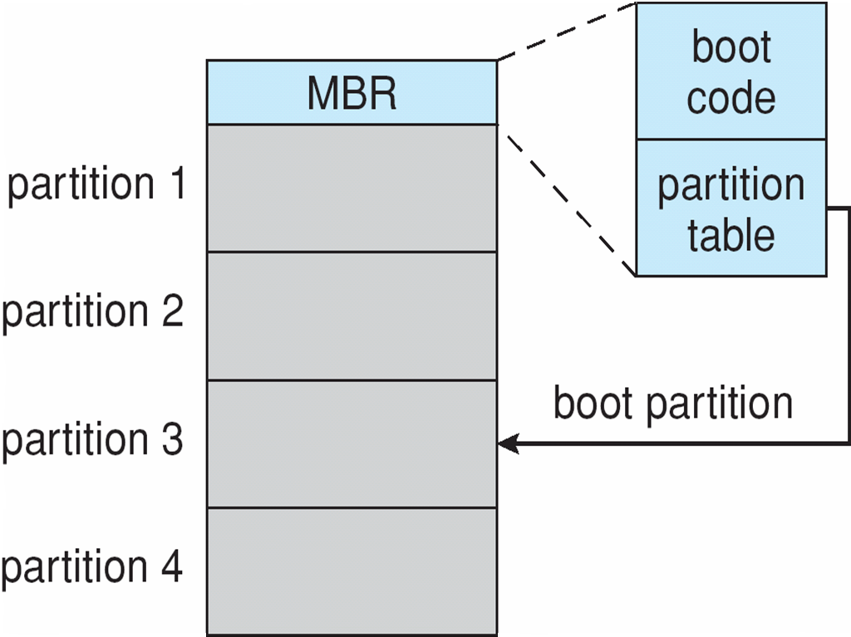
Booting from a Disk in Windows 2000
Master Boot Record(MBR)主引导记录
Boot record 引导记录
Notes:
Windows系统通过运行系统ROM上的代码，开始启动，指示系统从MBR读取引导代码。MBR包含一个硬盘分区列表和一个说明系统引导分区的标志。
引导分区，boot partition，包含操作系统和设备驱动程序。系统一旦确定引导分区，它读取该分区的第一个扇区，所谓引导扇区，并继续余下的启动过程，包括加载各种子系统和系统服务。

Slide 38
12.6 Swap-Space Management

Slide 39
Swap-Space Management
Swap-space — Virtual memory uses disk space as an extension of main memory
Swap-space can be carried out in two forms：
in the normal file system
e.g. Windows family
in a separate disk partition
e.g. Linux、Unix、solaris
pagefile.sys文件
SWAP分区
Notes:
交换空间太大容易造成浪费
交换空间太小容易造成死机现象：中断进程或使整个系统死机

Slide 40
Swap-space management
BSD allocates swap space when process starts; holds text segment (the program) and data segment
Kernel uses swap maps to track swap-space use
Solaris 2 allocates swap space only when a page is forced out of physical memory, not when the virtual memory page is first created

Slide 41
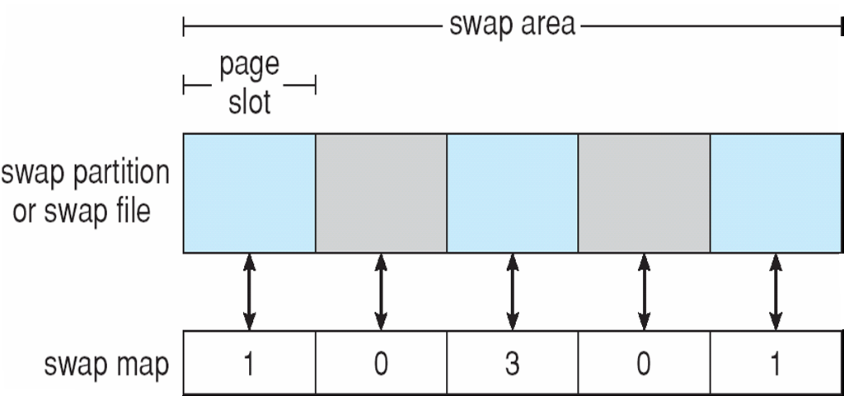
Data Structures for Swapping on Linux Systems

Slide 42
12.7 RAID Structure

Slide 43
RAID Structure
RAID ：Redundant Arrays of Inexpensive (independent) Disks（冗余廉价磁盘阵列） .RAID是一种把多块独立的硬盘（物理硬盘）按不同的方式组合起来形成一个硬盘组（逻辑硬盘），从而提供比单个硬盘更高的存储性能和提供数据备份技术。
Inexpensive -> Independent
RAID – multiple disk drives provides reliability via redundancy
Increases the mean time to failure
Frequently combined with NVRAM to improve write performance
RAID is arranged into six different levels（较早）

Slide 44
RAID (Cont)
Several improvements in disk-use techniques involve the use of multiple disks working cooperatively
Disk striping（条带化） uses a group of disks as one storage unit
RAID schemes improve performance and improve the reliability of the storage system by storing redundant data
Mirroring（镜像） or shadowing (RAID 1) keeps duplicate of each disk
Striped mirrors (RAID 1+0) or mirrored stripes (RAID 0+1) provides high performance and high reliability
Block interleaved parity (RAID 4, 5, 6) uses much less redundancy

Slide 45
RAID (Cont)
RAID within a storage array can still fail if the array fails, so automatic replication of the data between arrays is common
Frequently, a small number of hot-spare disks are left unallocated, automatically replacing a failed disk and having data rebuilt onto them

Slide 46
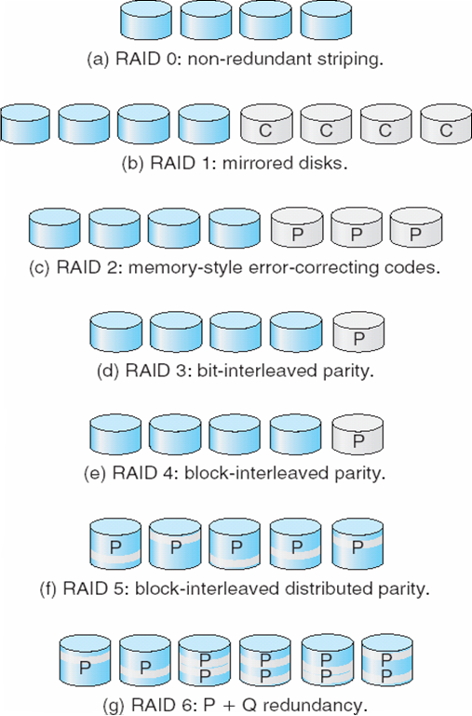
RAID Levels
P:纠错位
C:数据的第二拷贝
Hamming码
RAID2、3按字节或位striping
奇偶校验
按块striping
P+Q冗余，差错纠正码
Notes:
Raid 2：内存方式的差错纠正代码结构，内存系统中的每个字节都有一个相关奇偶位，以记录字节中置为1的个数是偶数还是奇数
Raid3和Raid4：奇偶校验码和其它磁盘的相应扇区或块一起用于恢复出错磁盘的扇区和块。
Raid5：将数据和奇偶校验分布在所有N+1块磁盘上
Raid6：保存了额外的冗余信息以防止多个磁盘出错，每4个位的数据使用了2个位的冗余数据，这样系统可以容忍两个磁盘出错。

Slide 47
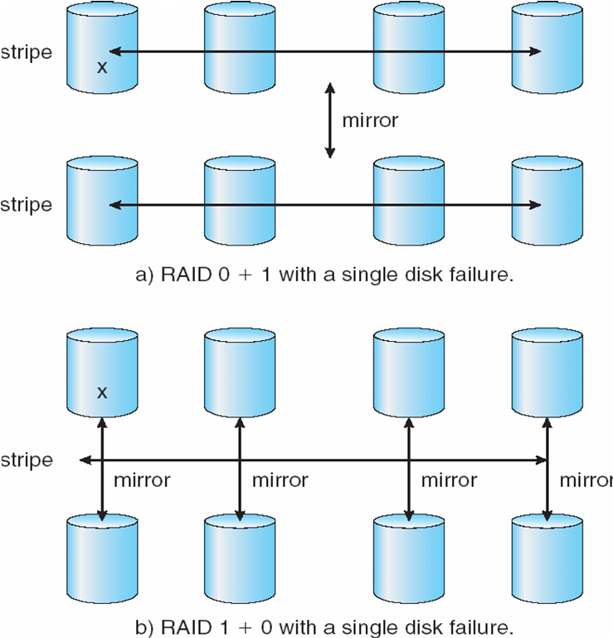
RAID (0 + 1) and (1 + 0)
Notes:
Raid0+1：raid0和raid1的组合，raid0提供性能，raid1提供可靠性。一组磁盘分散成条，每一条再镜像到另一条。RAID0+1允许坏多个盘，但只能在坏在同一个RAID0中，不允许两个RAID0都有坏盘
Raid1+0：先镜像，再分散。如果单个磁盘不可用，其它镜像仍如其它磁盘一样可用。RAID1+0允许坏多个盘，只要不是一对磁盘坏就可以
RAID 1+0在整体容错能力和恢复代价上比RAID 0+1更有优势，所以更为常用。

Slide 48
Extensions
RAID alone does not prevent or detect data corruption or other errors, just disk failures
Solaris ZFS adds checksums of all data and metadata
Checksums kept with pointer to object, to detect if object is the right one and whether it changed
Can detect and correct data and metadata corruption
ZFS also removes volumes, partititions
Disks allocated in pools
Filesystems with a pool share that pool, use and release space like “malloc” and “free” memory allocate / release calls

Slide 49
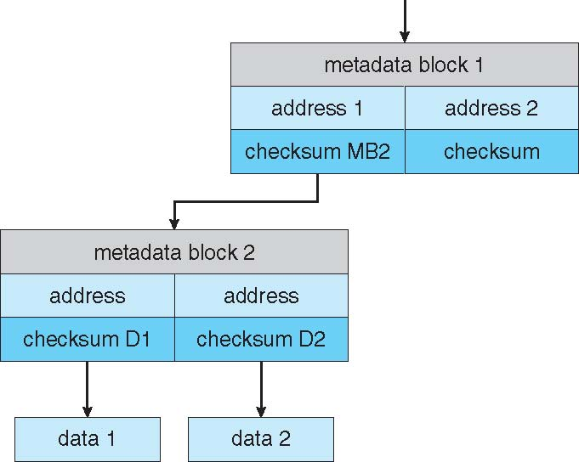
ZFS Checksums All Metadata and Data

Slide 50
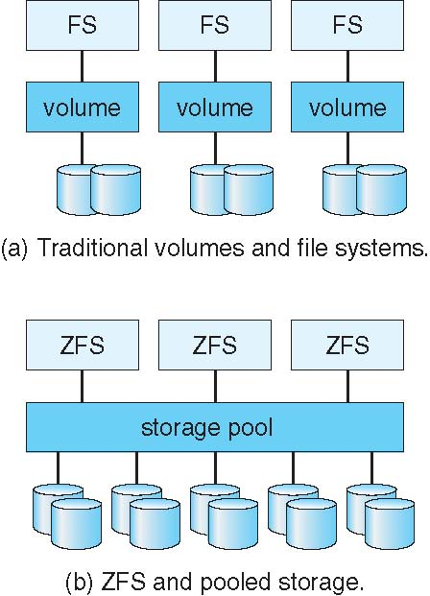
Traditional and Pooled Storage

Slide 51
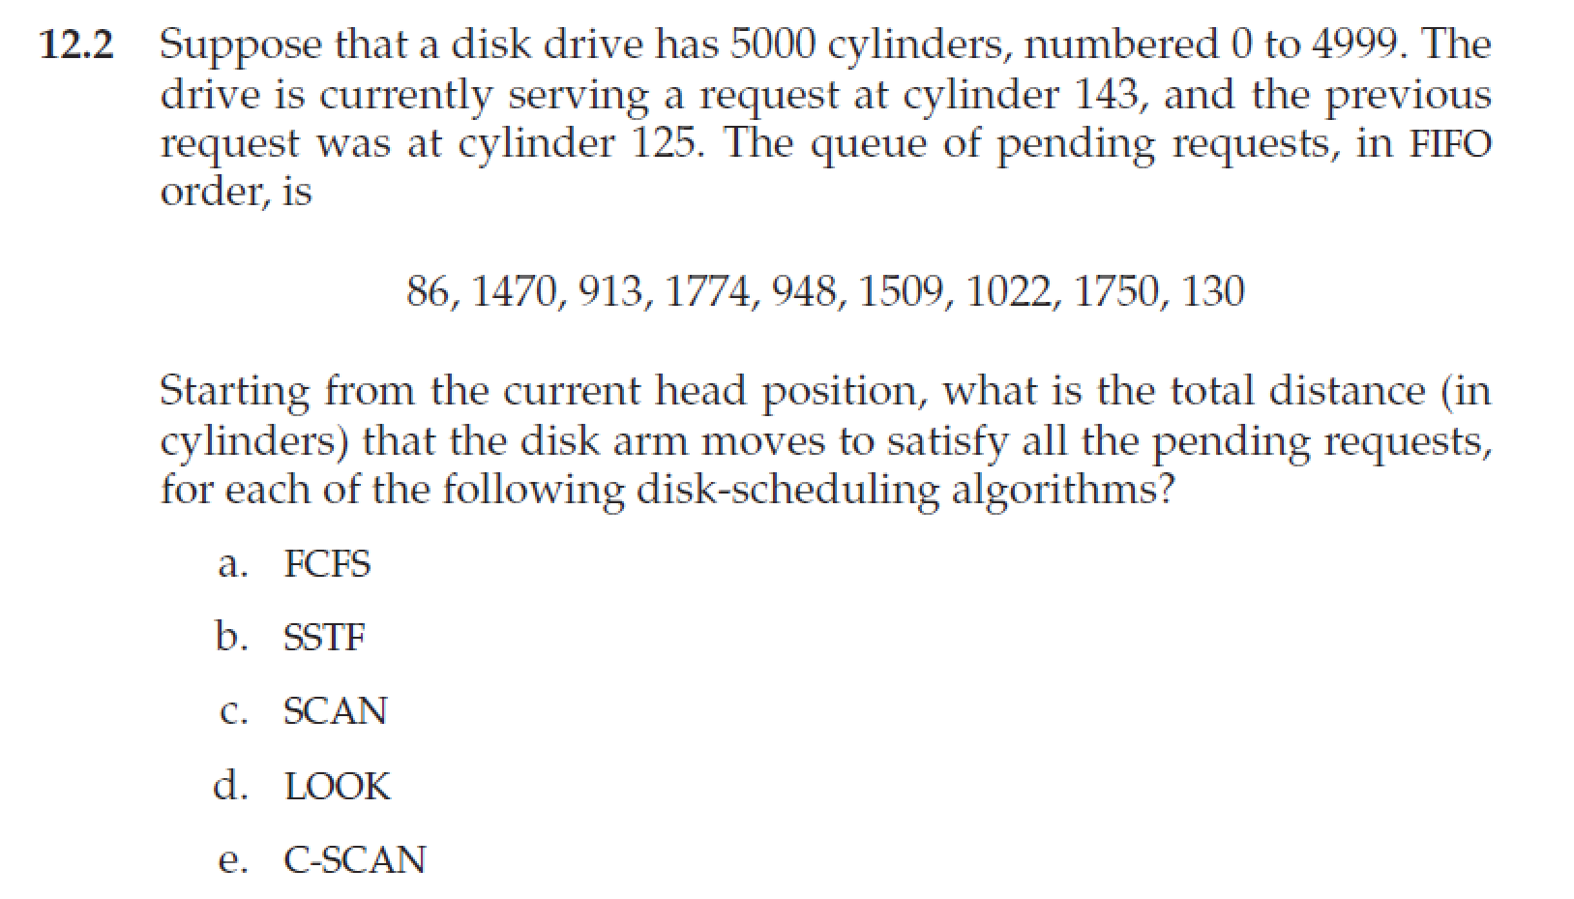
课堂习题

Slide 52
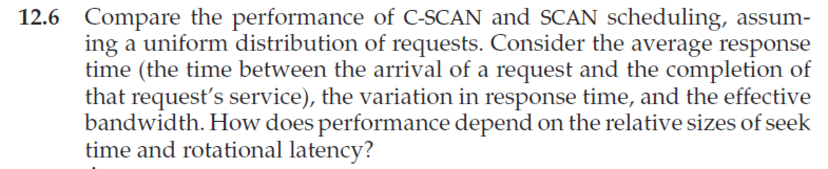
Homework
书后习题12.6
12月30日晚上12点前发邮件给TA（刘瑞峰，22021258@zju.edu.cn ），文件名以“学号-姓名-作业x”命名，例如“3170100000-张三-作业12”

Slide 53
End of Chapter 12

